Slide 1

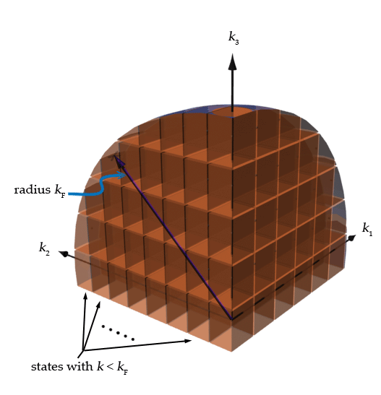
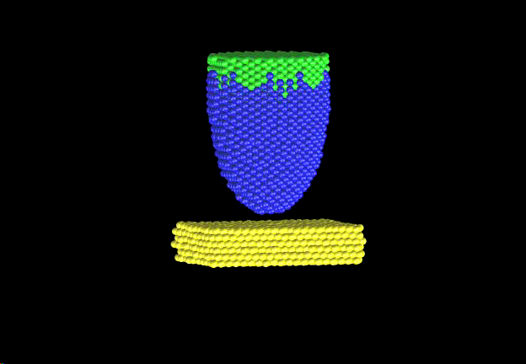
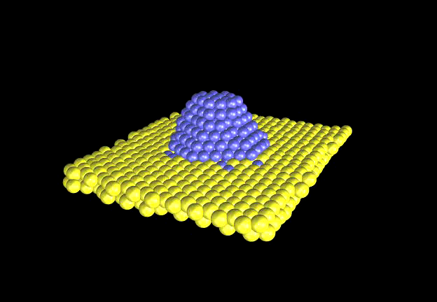
Quantum Interlude
Ezequiel P.M. Leiva
Departamento de Química Teórica y Computacional
Facultad de Ciencias Químicas
Universidad Nacional de Córdoba, Argentina

Slide 2
Quantum mechanics:
Independent particles
Momentum is replaced by momentum operator:
So that
Independent particles!

Slide 3
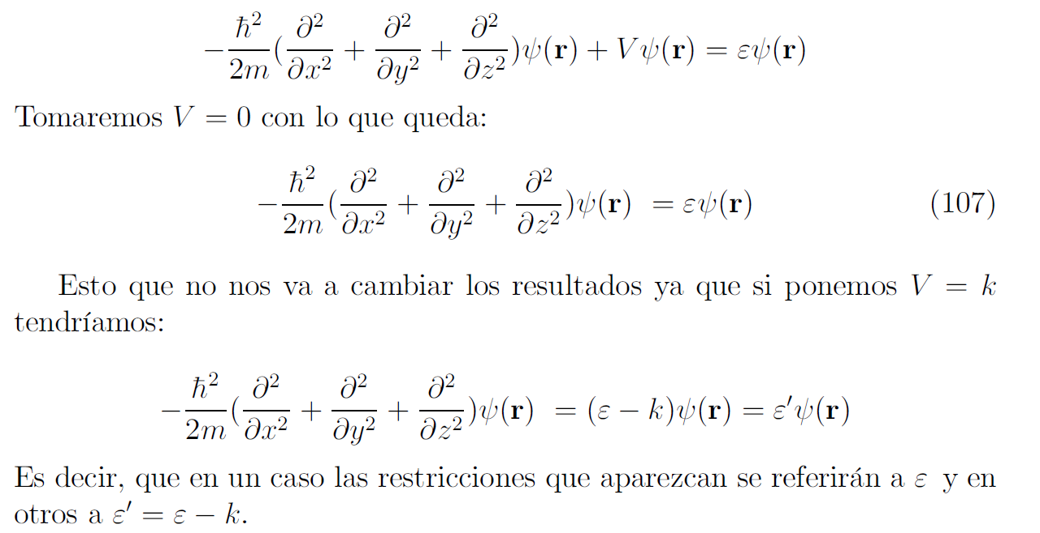
Quantum mechanics:
Independent particles
N independent particles moving in a box of volumen V of side L=V^{1/3}

Slide 4

What is k?

Slide 5
What is k?
Vector k is directly related to the momentm of electrons!
And also to their energy !!:

Slide 6




Boundary conditions
n_{x},n_{y},n_{z}
integers

Slide 7
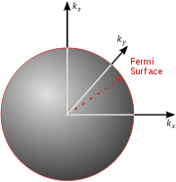
Each state (n_{x},n_{y},n_{z}) may host two electrons
Modulus of vector k that corresponds to the highest energy occupied state

Slide 8

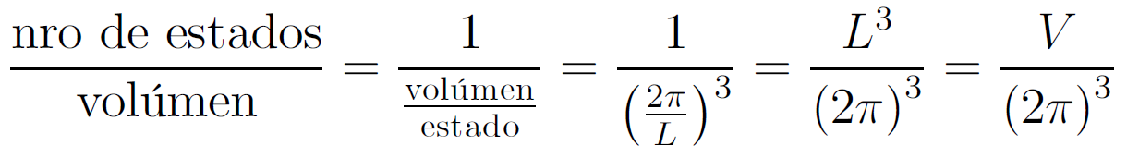

Each state (n_{x},n_{y},n_{z}) may host two electrons

Slide 9
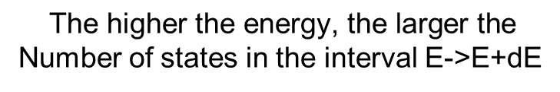
Degeneracy-Density of states
i.e.
(100), (010), (001)
Degeneracy: number of states with the same energy
Each state (n_{x},n_{y},n_{z})
may host two electrons
$$\text{All} \text{states} \text{with} \text{the} \text{same}|\vec{k}|\text{have} \text{the} \text{same} \text{energy}$$
$$The number of states per unit energy is:$$
$$\text{The} \text{higher} \text{the} \text{energy}\text{, }\text{the} \text{larger} \text{the}$$
Number of states in the interval E->E+dE

